Slide 1
CSC8113 Group Project
Team 3
Alexandros, Rantos-Charisopoulos A.Rantos-Charisopoulos2@newcastle.ac.uk
Christos,Grigoriadis C.Grigoriadis@newcastle.ac.uk
Yuchen,Guo Y.Guo32@newcastle.ac.uk
Zhiniu,Wu Z.Wu26@newcastle.ac.uk
Shiwei,Mo S.Mo2@newcastle.ac.uk
Ziqi,Cui Z.Cui7@newcastle.ac.uk

Slide 2
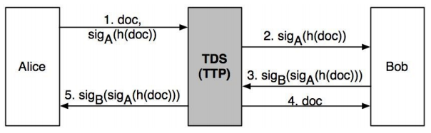
Project Scope
Design and develop a Trusted Third Party (TTP) fair exchange service (system),
Using Amazon Web Services (AWS),
Based on the protocol steps of the depicted protocol below:
Add a document to the store (Step 1)
Request an identified object(Step 2 - returning the signature)
Get a document (Steps 3 and 4)
Get a receipt associated with the document (Step 5)
Guarantee Fairness

Slide 3
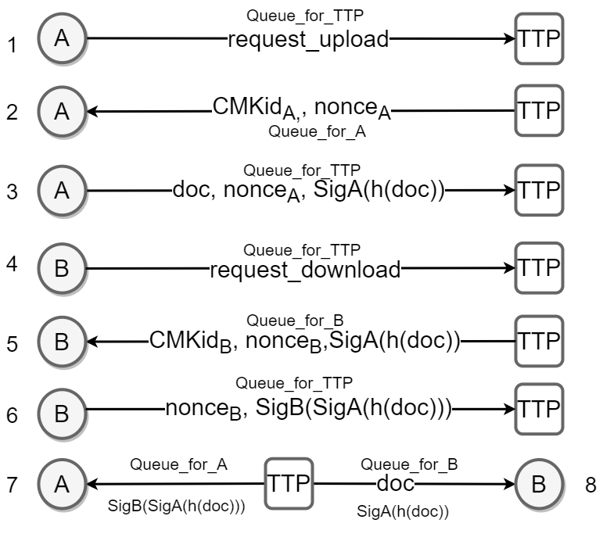
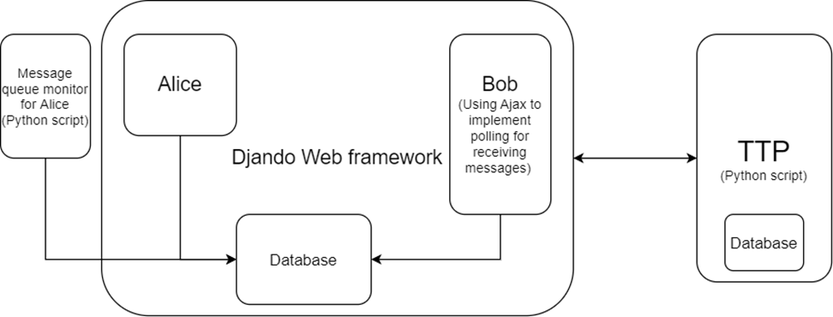
Project’s Protocol Implementation
Protocol is split into 8 different steps. Last two steps are performed transactionally to ensure fairness. Each step will be explained thoroughly after the illustration of the design approach.
System Structure

Slide 4
Design: Technologies Used
Amazon Web Services:
Amazon Simple Queue Service (SQS) for message transmission between Client and TTP(or TDS) .
Amazon Key Management Service (KMS) for sign and verification of messages on both sides.
Amazon Simple Storage Service (S3) for document manipulation on both sides.
Amazon Relational Database Service (RDS) for database manipulation on TTP side.
Amazon Elastic Cloud Service (EC2) to run the system online.
Programming Languages and Framework:
Python is our main programming language
Django Web framework is used in our Client side (Sender and Receiver)
HTML, CSS and javascript for Front-end design and implementation of Client
Postgresql & mySQL for databases

Slide 5
Design: Message Transmission 1/3
Decided to use AWS SQS (Simple Queue Services for each part of the design (sender, received and TTP).
We split the project as Client Side (Alice and Bob) and Server Side (TTP), note that a Client can upload or download a document.
3 Queues are implemented for sender, receiver and TTP respectively.
Each entity listens to its own message queue, and each message is sent to the corresponding queue rather than broadcasted to all queues.
Each entity is using polling to receive new messages.
Queue structure is FIFO (First-In-First-Out) and messages are securely transmitted through SSE encryption, thus messages cannot be tampered and if intercepted no information can be gained.
Referencing the depicted graph on the right, an Arrow (which is a message transmission) from Alice or Bob to TTP is sent to TTP Queue. Arrows from TTP to Alice, are messages sent to A Queue (or sender queue). Lastly, Arrows from TTP to Bob are messages sent to B Queue (or receiver queue).

Slide 6
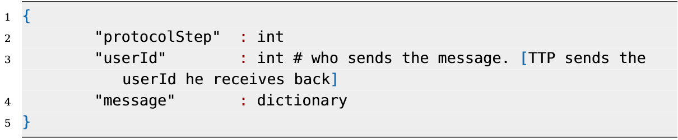
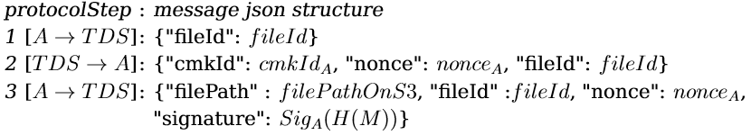
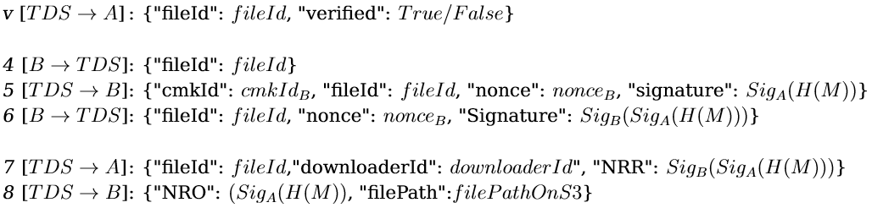
Design: Message Transmission 2/3
For Queue’s messages we use a generic json structure for every transmission throughout the protocol:
Message dictionary content varies, depending on the protocol step. More specifically, the content of the dictionary per protocol step is:

Slide 7
Design: Message Transmission 3/3
Clarification of message dictionary variables:
FileId -> Unique identifier of the file to be uploaded
CmkId_{X} -> Key ID assigned to user X
FilePath -> File path of the file in S3 Bucket
Nonce -> Random number generated for security purposes
Signature_{X}(M)-> Signature generated by user X, by signing message M
NRO -> Non-Repudiation evidence of Origin
NRR -> Non-Repudiation evidence of Receipt
DownloaderId -> ID of user that requested the file

Slide 8
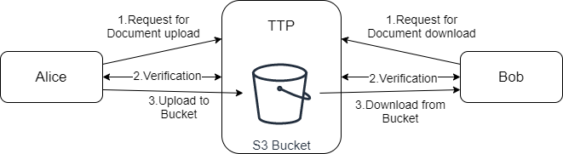
Design: Document Manipulation
Used AWS S3 (Simple Storage Service) for document upload and download
Users (via Django framework and Front-end) can upload a document to TTP’s S3 storage and after successful verification, the document is considered “verified”.
Users can also download a “verified” document, only after a successful verification scenario
Verifications and Signatures will be discussed thoroughly in the next slide
S3 gives us the privilege to upload files in general (such as images, .txt files) and not only documents.

Slide 9
Design: Sign and Verify
Use of AWS KMS (Key Management Service) in both Client and TTP side.
TTP is generating a key-pair (using elliptic curve cryptography scheme ECC_NIST_P256 to further reduce key size) for every user in our system, once they request to either upload a file or request to download one.
The key ID is sent over the Queues to let Alice or Bob sign (either Sig_{A} or Sig_{B})
TTP will receive from its Queue signatures signed by users and can verify them using their key ID.
To guarantee correct signature, for the appropriate message, TTP is re-creating the hash of the uploaded file in Step 1 of the graph below and performs verification. The same approach is used for verification in Step 3 of graph, by inputting as Sig_{B}’s message, the appropriate NRO.

Slide 10
Step by step protocol explanation: Step 1 and 2
Note that the protocol step and user Id is sent in each message transmission!
A is requesting to upload a file with a file ID.
TTP (after receiving protocol step 1), responds with protocol step 2, generating key ID (or sends an already existing key for the current user), a nonce and sending back the file ID

Slide 11
Step by step protocol explanation: Step 3 and v
After A received protocol step 2, A uploads the file on TTP’s S3 Bucket and sends the file path on S3, the file ID, the nonce that was previously generated and the Sig_{A} of the doc (or file).
TTP (after receiving protocol step 3), responds with protocol step v, sending back the file ID and a boolean called verified, that is True, if and only if, nonce and signature are verified. Upon verification the file is successfully uploaded.

Slide 12
Step by step protocol explanation: Step 4 and 5
B sends to TTP protocol step 4, with the file ID of the file that B wants to download.
TTP (after receiving protocol step 4), responds with protocol step 5, generating key ID (or sends an already existing key for the current user), a nonce and sending back the file ID as well as the signature generated from the uploader (or entity A) of the specified file.

Slide 13
Step by step protocol explanation: Step 6, 7 and 8
After B receives from TTP protocol step 5, B returns the previously generated nonce and a Sig_{B} , signing the NRO of the specified document.
TTP (after receiving protocol step 6), responds with protocol step 7 and 8.
Step 7 sends the file ID of the specified document, the user ID of the downloader (or entity B) and the NRR to the uploader (or entity A).
Step 8 sends the NRO of the specified document and the actual file path on S3 to download.

Slide 14
Implemented Protocol extensions:
Security extension
SSE encryption for AWS SQS
Restricted access of AWS services only to specific security groups & users
Abort protocol implementation
A can request an abort
Abort is successful only when B has not obtained NRO & doc and A has not obtained NRR
Fairness guaranteed

Slide 15
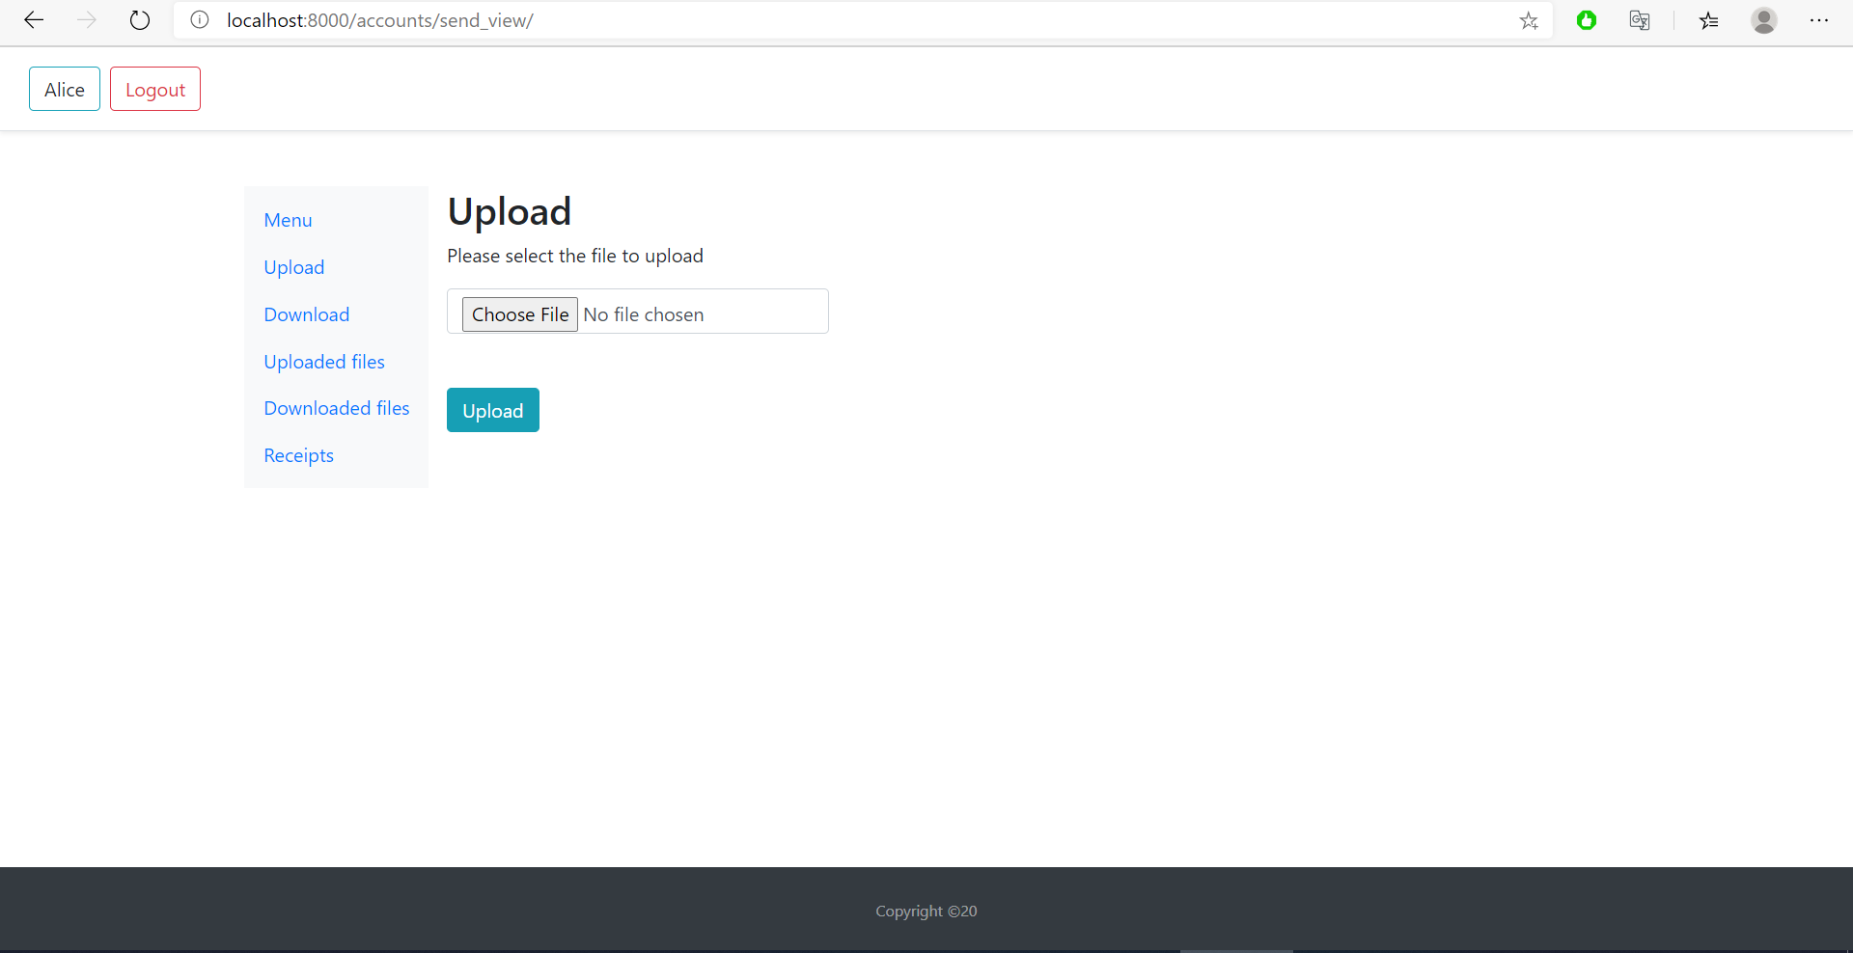
User interface (1/5): Upload a file
A registered user can request to upload a file through this page. The upload button fires the protocol and sends a message to TTP Queue in order to get a verification for the particular upload

Slide 16
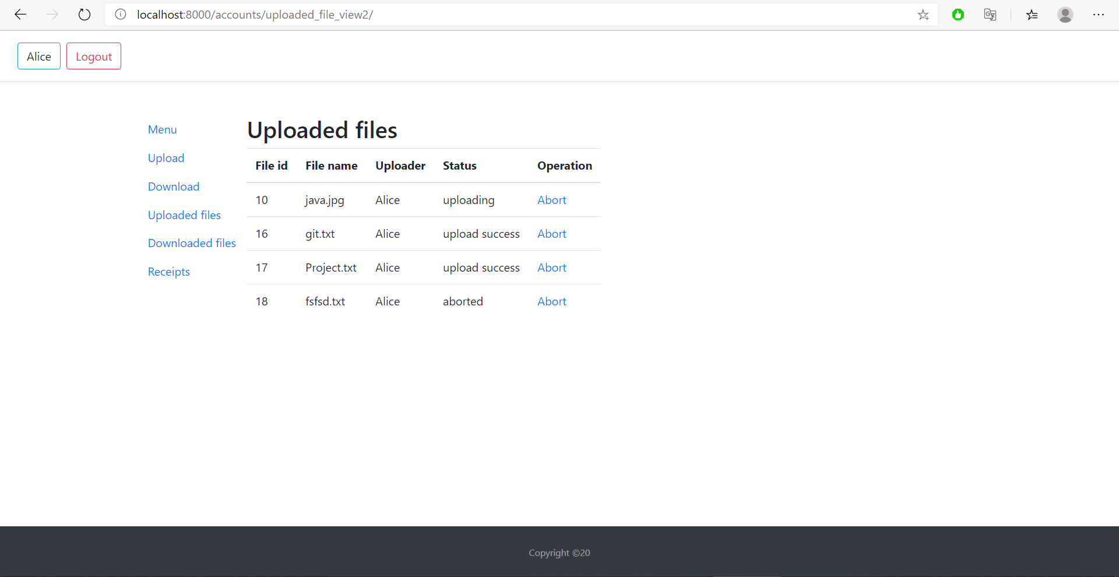
User interface (2/5): Uploaded files
The status of each requested uploaded file is shown here for the currently logged user.
Uploading means that TTP has not verified the file yet, while uploaded means that the file is uploaded and the NRO is verified and saved on TTP.
There is an option to request an abort for any file. If successful, the Status will change to aborted.

Slide 17
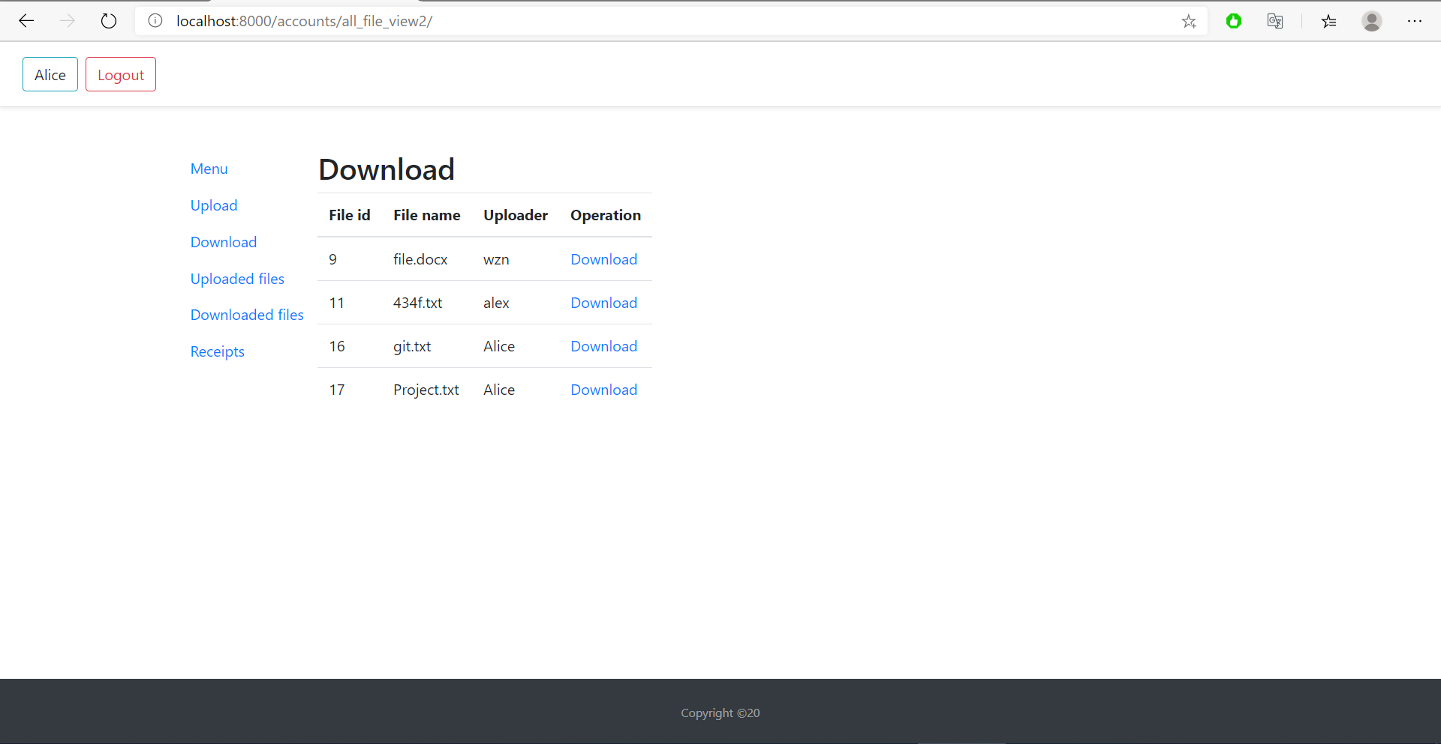
User interface (3/5): Download a file
From this page a logged in user can request a specific file to download.
The download operation sends a request message into TTP Queue for the corresponding file.

Slide 18
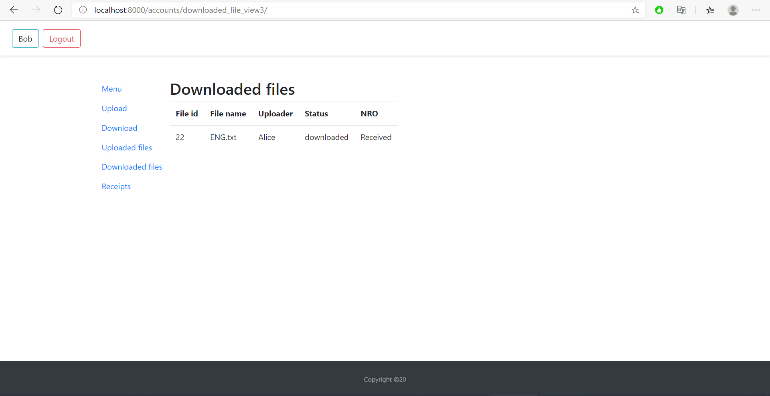
User interface (4/5): Downloaded files
Shows all the downloaded files from each registered user.
Downloaded stands for a verified download request and the user has received the NRO and the file.

Slide 19
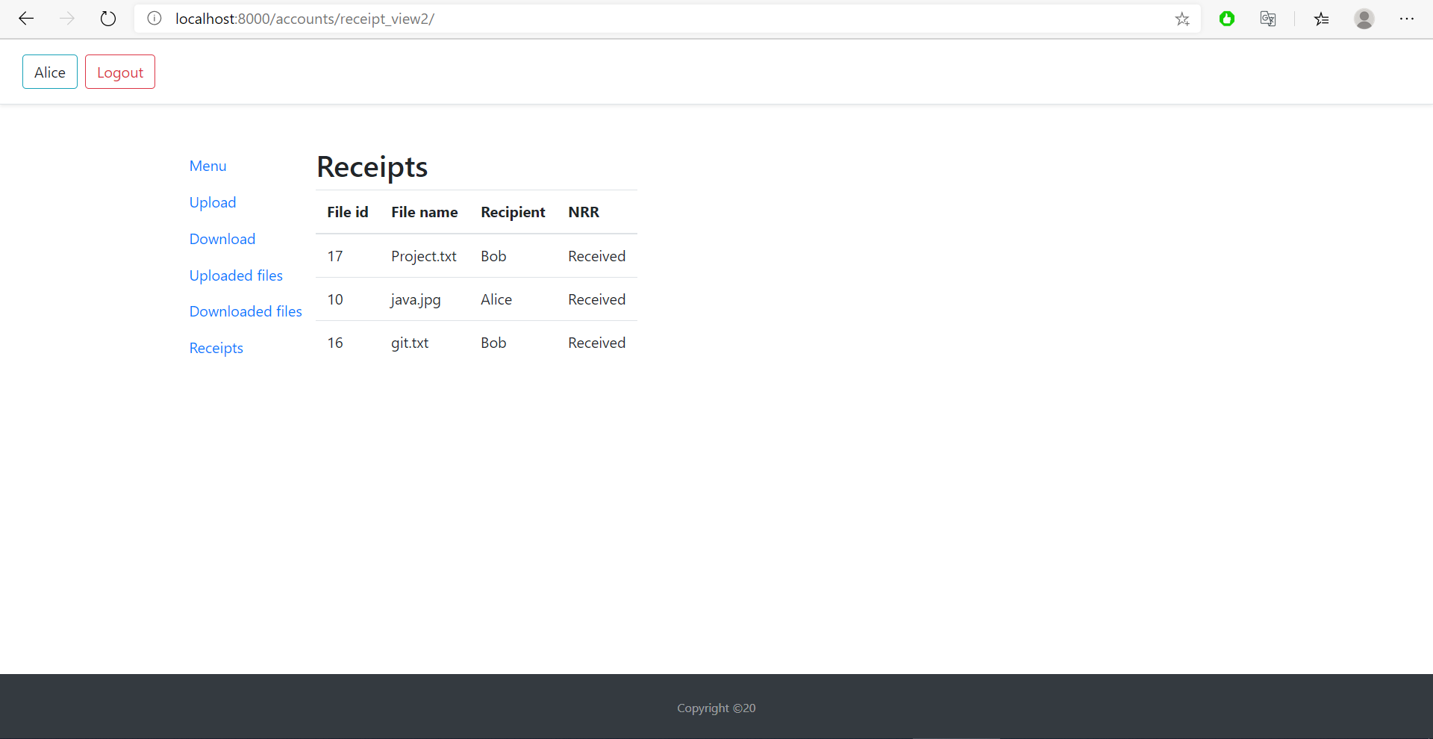
User interface (5/5): Receipts
Shows every verified download that was performed by each user.
Each recipient has received an NRR and each uploader of each file has received the corresponding NRO.

Slide 20
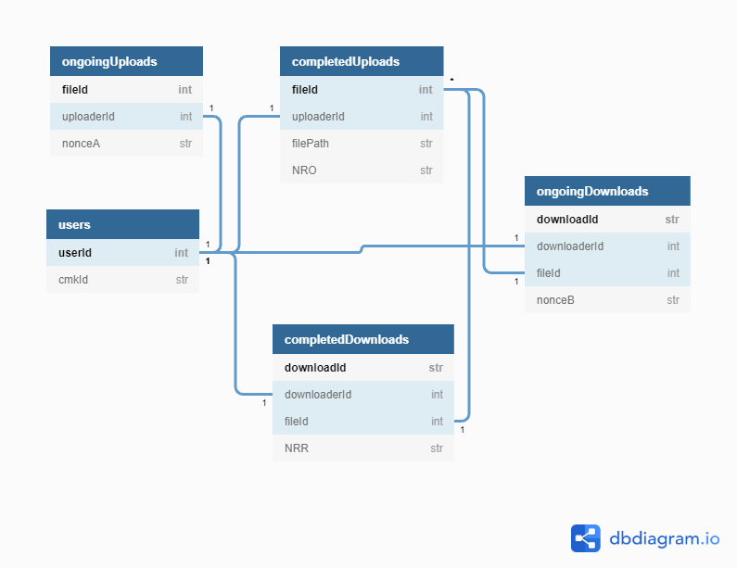
Database Schema: TTP/TDS
Users table to store each users cmkId.
Split uploads and downloads into two tables. The requests that are pending (ongoing) and the verified ones (completed).
Each pending requests when verified, the corresponding row from ongoing table gets transferred to the completed one.
Use of Foreign Keys & relationships to establish data integrity.
Download only files from CompletedUploads table
Uploader/Downloader must exist as a user in system
Cascade update/deletion
For easier record retrieval; downloadId = downloaderId + “_” + fileId.
Simple & Scalable database design

Slide 21
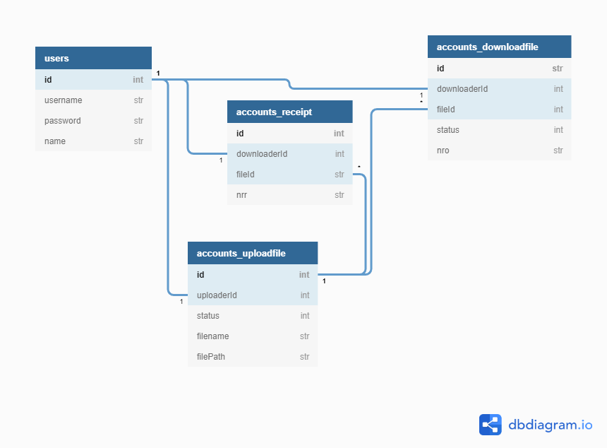
Database Schema: Client
Accounts_receipt depicts each receipt given.
Accounts_downloadfile shows all the downloaded files and Accounts_uploadfile all the uploaded files
Accounts_uploadfile status:
0 == fail upload
1 == uploaded
2 == uploading
3 == abort
Accounts_downloadfile status:
1 == downloaded
2 == downloading
Use of Foreign Keys & relationships to establish data integrity.

Slide 22
Conclusion: Pros and Cons
Pros
Cons
Amazon Simple Queue Service (SQS) simple, user-friendly interface and SSE encryption
Amazon Key Management Service (KMS) simplistic and secure, sign and verification methods and key storage.
Amazon Simple Storage Service (S3) guarantees scalability and accepts any file type rather than document files only.
Amazon Relational Database Service (RDS) secure, auto-scalable, persistent storage.
Django Framework pre-built authentication system & security middleware.
Expensive system design for high-demand/high-traffic applications; multiple AWS pile up the cost.
Relatively costly SQS Service (50 cents per million requests in FIFO queues) in comparison to a free REST API, handling HTTP requests.
SQS requires polling; system might be idle when message needs to be processed.

